Slide 1

THE PROCESSOR Performance

Slide 2

Factors affecting CPU performance

Slide 3


Factors affecting CPU performance
Instruction set
Multiple cores
Cache memory
Clock speed
Word Length
Address Bus width
Data bus width

Slide 4
Students’ Activity
For each of the following factors in groups/pairs or individually do research and then report back to the class your findings
Instruction set
Multiple cores
Cache memory
Clock speed
Word Length
Address Bus width
Data bus width

Slide 5

Teacher concept review

Slide 6
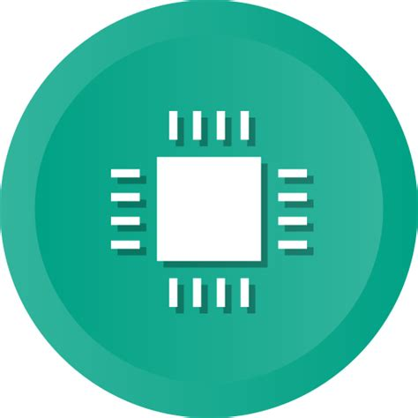
Instruction Set
The instruction set is the processor's built-in code that tells it how to execute its duties. It's something that's coded into the chip when it's manufactured and that you can't change.
The processor's architecture and instruction set determine how many cycles, or ticks, are needed to execute a given instruction.
Some instruction sets are more efficient than others, enabling the processor to do more useful work at a given speed.

Slide 7
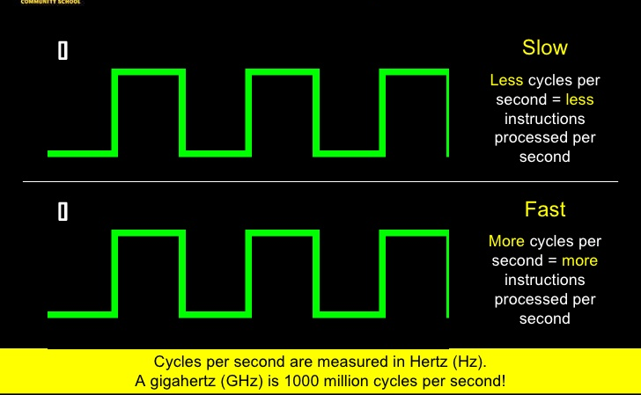
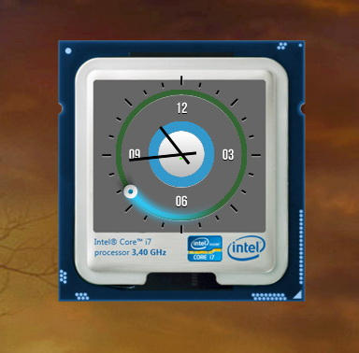
CLOCK SPEED
Clock speed is the number of pulses the central processing unit's (CPU) clock generates per second.
The clock speed (or clock rate) is stated in megahertz (MHz) or gigahertz (GHz), and refers to the speed at which the processor can execute instructions. The more pulses per second, the more fetch-decode-execute cycles that can be performed and the more instructions that are processed in a given space of time.
Processors with faster clock speeds process data faster than those with slower clock speeds. To speed of the clock speed of the CPU overclocking can be done but this can cause long term damage to the CPU as it is working harder and producing more heat.

Slide 8
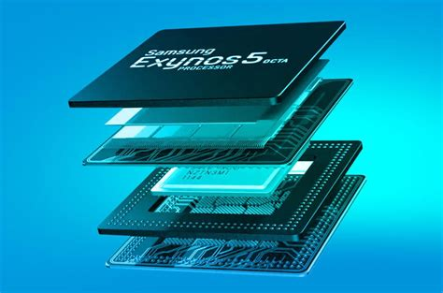
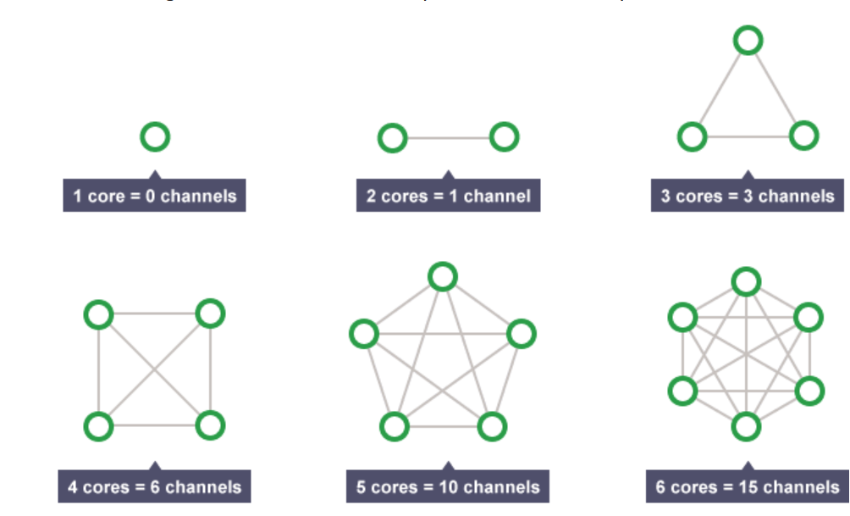
PROCESSOR CORE
A CPU can contain one or more processing units. Each unit is called a core. A core contains an ALU, control unit and registers. It is common for computers to have two (dual), four (quad) or even more cores.
Increasing the core of the CPU improves performance in the following ways:
Multi-tasking is the ability to carry out more than one task at the same time. A two cores, a CPU can run two tasks simultaneously. A quad core can handle four simultaneous tasks.
Parallel processing is when a single task (program) is split into two or more parts and each part is processed at the same time. This would double performance on a dual core cpu as each part is processed independently. This is not always true because many programs cannot be split neatly into two independent parts. This is because they are mostly sequential i.e. each task depends on the outcome of a previous task and so it has to wait for the first task to be completed.

Slide 9
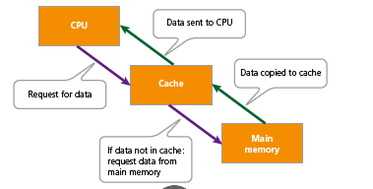
Cache size
Close to the CPU is a very fast (and expensive) type of memory called cache memory.
This is where instructions that the computer is likely to reuse are stored. Since constantly fetching instructions from RAM can be slow, the CPU checks the cache memory for instructions before checking RAM, to help speed up the process.
This means that the more cache there is, the more of these quick reference instructions can be stored, and therefore the faster the computer can run.

Slide 10
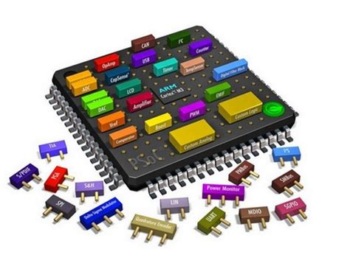
Word Size/Length/ width
The word size/length refers to the maximum number of bits that a CPU can process at a time
This word length is the word length of a CPU . The usual length is 8, 16, 32, 64 however 32 and 64 are more common
The bigger the word length the bigger the operand. If the operand and result exceed the word length, extra processing is need to split the operand into different registers. This will take more time for processing therefore reducing the processing speed.

Slide 11
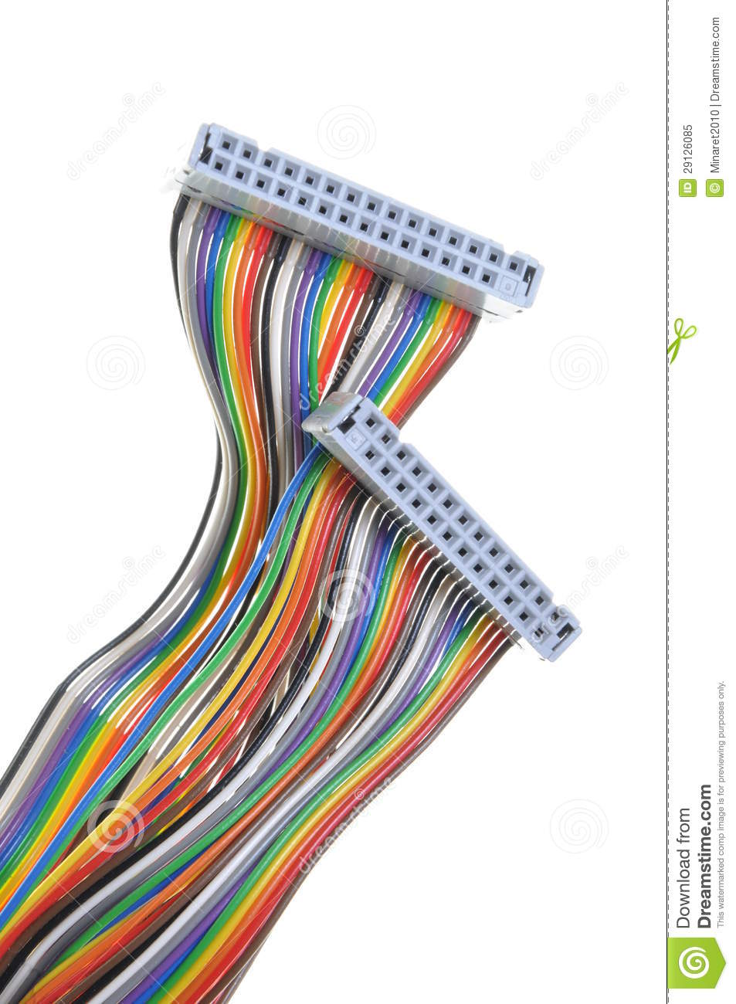
BUS WIDTH
A bus is simply a circuit that connects one part of the motherboard to another.
The more data a bus can handle at one time, the faster it allows information to travel.
The speed of the bus, measured in megahertz (MHz), refers to how much data can move across the bus simultaneously.

Slide 12
Data Bus Width
The data bus/wires are used to transfer the data bits (binary digits) between the CPU and memory
The data bus/wires are used to transfer the data bits (binary digits) between the CPU and memory
The wider or more wires the data bus, the more data you can transfer per time unit (second)
That will result is a faster running computer

Slide 13
Address Bus Width
Each wire of the address bus can transfer 1 bit of the address and an address bus that contains n wires can convey n bits
The width of the address bus determines the size of the memory that the computer can use
The wider the address bus, the more memory a computer can use. (More memory allows the computer to store more data and solve larger size problems, e.g., sort more data)

